Slide 1
自然语言处理
第07章 向量语义与嵌入
西工大软件学院 刘春
参考：Dan Jurafsky《自然语言处理》

Slide 2
本章内容
7.1 词的语义学
7.2 向量语义学
7.3 词的向量表示法
7.4 TFIDF词向量
7.5 Word2vec词向量

Slide 3
词的语义学
词义
一种含义或概念，是一个词的词义成分
不同词义成分之间具有联系
词义：包括词的本义、引申义、比喻义。一个词的最初的含义称作本义。以本义为出发点，根据它所反映的事物或现象的各个特点，词在它的发展过程中又会产生若干个与本义相关但并不相同的意义，这就是词的引申义。词义的性质包括概括性、客观性和民族性。

Slide 4
关系1：同义(Synonymy)
同义词：在一些或者所有情况具有相同含义
  filbert / hazelnut 榛子
  couch / sofa 沙发
  big / large 大
  automobile / car 汽车
  vomit / throw up 呕吐
  Water / H₂O 水

Slide 5
关系1：同义
没有完美的同义关系
  仅仅在某些方面具有完全一样的含义
  仍然具有差异性，例如：礼貌用语，哩语，语体风格，类型等等

Slide 6
关系1：同义？
  Big/large
  my big sister != my large sister

Slide 7
关系2：反义(Antonymy)
含义在词义的一个方面完全相反
其他方面，具有很高的相似性！
  dark/light short/long fast/slow rise/fall
  hot/cold up/down in/out
反义词
  定义了一个二元对立面或者某种程度对立的两端
    long/short, fast/slow
  相反方向的变化：
    rise/fall, up/down

Slide 8
关系3：近义(Similarity)
    单词具有相似的含义。不是同义但含义在某个方面具有共性
    car, bicycle
    cow, horse

Slide 9
两个词的相似程度
word1 | word2 | similarity
vanish | disappear | 9.8
behave | obey | 7.3
belief | impression | 5.95
muscle | bone | 3.65
modest | flexible | 0.98
hole | agreement | 0.3
SimLex-999 dataset (Hill et al., 2015)

Slide 10
关系4：词的关联性(Relatedness)
也称为“词的联想”
词通过语义框架或者语义场联系
    car, bicycle: 近义
    car, gasoline: 关联但不是近义

Slide 11
语义场
词集满足
  覆盖特定的语义领域
  相互之间有着结构性的关系
  hospitals
  surgeon, scalpel(手术刀), nurse, anaesthetic(麻醉剂), hospital
  restaurants
  waiter, menu, plate, food, chef(厨师)),
  houses
  door, roof, kitchen, family, bed
Notes:
语义框架与角色
一组表示特定类型事件的透视图或参与者的单词集合
例：
商业交易

Slide 12
关系5：内涵(Connotation)
单词具有情感含义或内涵
积极内涵 (高兴)
消极内涵(悲伤)
积极评价 (伟大, 爱)
消极评价 (可怕, 恨)
Notes:
“内涵”一词在不同的领域有不同的含义，但在这里，我们用它来表示与作者或读者的情感、情绪、意见或评价有关的词义的各个方面

Slide 13
本章内容
7.1 词的语义学
7.2 向量语义学
7.3 词的向量表示法
7.4 TFIDF词向量
7.5 Word2vec词向量

Slide 14
词义计算模型
构建一个词义表示的理论？
1.定义法
2.向量语义模型(vector semantics)
标准模型！
Notes:
Vector semantics is the standard way to represent word meaning in NLP, helping us model many of the aspects of word meaning we saw in the previous section. The roots of the model lie in the 1950s when two big ideas converged:

Slide 15
词义计算模型
Ludwig Wittgenstein
PI #43:
  “The meaning of a word is its use in the language”（词的含义是其在语言中的用法）

Slide 16
词义计算模型
Notes:
渔具是为捕鱼而存在的，鱼捕到了渔具就被忘了。语言是为表达思想而存在的，思想表达了，语言就被忘了。

Slide 17
词义计算模型
如何定义词的用法
通过词的环境来定义(词的上下文)
Zellig Harris (1954):
如果A和B有几乎一样的上下文环境，我们说他们是同义词。

Slide 18
词义计算模型
新词猜义—空心菜(ongchoi)的含义是什么？
假设看到以下句子：
Ong choi is delicious sautéed with garlic.
Ong choi is superb over rice
Ong choi leaves with salty sauces
同时看到以下句子：
…spinach sautéed with garlic over rice
Chard stems and leaves are delicious
Collard greens and other salty leafy greens
结论：
  Ongchoi is a leafy green like spinach, chard, or collard greens

Slide 19
词义计算模型
思路 1：使用词语用法中词的分布定义词义
通过词使用时所处的环境分布定义词义，即使用邻域词或语法环境
Notes:
So we can express this first intuition as Idea 1:

Slide 20
词义计算模型
思路 2：词义空间中的一个点 (Osgood et al. 1957)
例：3 情感维度
  valence: pleasantness（愉悦度）情感状态的正、负特性
  arousal: intensity of emotion （激活度）情绪生理激活水平和警觉性
  dominance: the degree of control exerted （优势度）表示情绪对他人和外 界环境的控制力和影响力
词的含义是3维空间中的一个向量
 | Word | Score |  | Word | Score
Valence | love | 1.000 |  | toxic | 0.008
 | happy | 1.000 |  | nightmare | 0.005
Arousal | elated | 0.960 |  | mellow | 0.069
 | frenzy | 0.965 |  | napping | 0.046
Dominance | powerful | 0.991 |  | weak | 0.045
 | leadership | 0.983 |  | empty | 0.081
NRC VAD Lexicon
(Mohammad 2018)
Notes:
And the second idea is Osgood’s (1957) idea mentioned in the prior lecture, in which the connotation of a word is represented by 3 numbers, it's valence, arousal, and dominance. That means we are essentially representing a word's connotation by a point in three-dimensional space! But suppose we represent more than just a word's connotation

Slide 21
词义计算模型
每个词= 一个向量
  不仅仅是“词” 或 词45.
相似词位于“近邻空间"

Slide 22
词义计算模型
使用向量定义一个词
“嵌入”
词嵌入于一个空间之中
词向量
NLP中表示词义的标准方法
词义相似的细粒度模型

Slide 23
词义计算模型
为什么使用向量进行表示？
考虑情感分析：
  基于特征的方法——一个词只能表示单一实体
    特征 5: 词的前一个单词是"terrible”’
    训练和测试过程中需要提取一模一样的词
  使用嵌入:
    特征为一个词向量
    词的前一个词，向量是[35,22,17…]
    如果词的前一个词向量[34,21,14]，仍然符合要求
    词义相似性得到泛化

Slide 24
词义计算模型
2 种不同嵌入方法
Tf-idf
  基线模型
  稀疏向量
  词被表示为一个邻接词对数量的函数
Word2vec
  密集向量
  通过训练一个分类器区分近邻和非近邻词汇得到词的表示

Slide 25
本章内容
7.1 词的语义学
7.2 向量语义学
7.3 词的向量表示法
7.4 TFIDF词向量
7.5 Word2vec词向量

Slide 26
文档向量表示
词项-文档 共生矩阵
每个文档表示为词的向量

Slide 27
文档向量表示
可视化文档向量

Slide 28
文档向量表示
两个喜剧的向量是相似的
与历史剧不相同
喜剧有更多的fools和wit，较少的battles

Slide 29
文档向量表示
battle 是一种经常出现在 Julius Caesar和Henry V的词汇
fool 是一种经常出现在喜剧中的词汇，尤其是Twelfth Night"

Slide 30
词的向量表示
两个词相似，则它们具有相似的上下文
词-词共生矩阵

Slide 32
词的向量表示
向量相似性度量
向量长度

Slide 33
词的向量表示
余弦度量
v_{i} 是词v在上下文i 上的数量
w_{i}是词w在上下文i 上的数量
Cos(v,w) 是向量v和向量w的余弦相似度
Notes:
See Law of Cosines (Cosine Rule) wikipedia page

Slide 34
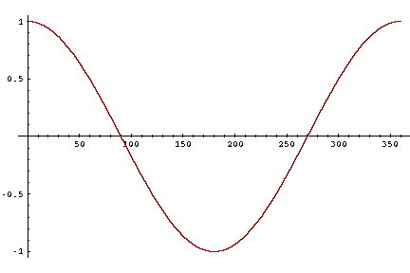
词的向量表示
余弦相似度量
-1: 两向量方向相反
+1: 两向量方向相同
0: 两向量正交

Slide 35
 | pie | data | computer
cherry | 442 | 8 | 2
digital | 5 | 1683 | 1670
information | 5 | 3982 | 3325

Slide 36
词的向量表示
可视化cosines

Slide 37
本章内容
7.1 词的语义学
7.2 向量语义学
7.3 词的向量表示法
7.4 TFIDF词向量
7.5 Word2vec词向量

Slide 38
TFIDF词向量
频率表示方法的缺点
如果sugar经常出现在apricot周围，频率是有效的，是有用的信息
但是一些高频词，如the, it, 或 they ，对于上下文词没有意义
需要一个新的关于频率的函数解决这个问题！

Slide 39
TFIDF向量
词频(tf)
tf_{t,d} = count(t,d)
一般还会进行对数处理：
tf_{t,d} = log₁₀(count(t,d)+1)或
1+log₁₀(count(t,d))
Notes:
The tf-idf algorithm (the ‘-’ here is a hyphen, not a minus sign) is the product of two terms, each term capturing one of these two intuitions. The first is the term frequency: the frequency of the word t in the document d. We can just use the raw count as the term frequency: EQ
More commonly we squash the raw frequency a bit, by using the log10 of the fre- quency instead. The intuition is that a word appearing 100 times in a document doesn’t make that word 100 times more likely to be relevant to the meaning of the document. Because we can’t take the log of 0, we normally add 1 to the count:

Slide 40
TFIDF向量
文档频率(df)
df_{t}出现词 t的文档频次.
“Romeo”是Shakespeare的一个显著特征词：
Notes:
The second factor in tf-idf is used to give a higher weight to words that occur only in a few documents. Terms that are limited to a few documents are useful for discriminating those documents from the rest of the collection; terms that occur frequently across the entire collection aren’t as helpful. The document frequency dft of a term t is the number of documents it occurs in .
Document frequency is not the same as the collection frequency of a term, which is the total number of times the word appears in the whole collection in any document. Consider in the collection of Shakespeare’s 37 plays the two words Romeo and action. The words have identical collection frequencies (they both occur 113 times in all the plays) but very different document frequencies, since Romeo only occurs in a single play. If our goal is to find documents about the romantic tribulations of Romeo, the word Romeo should be highly weighted, but not action:
Important: documents can be anything, they don't have to be original documents. For example we often treat each paragraph as a document, which lets use compute tf-idf values for

Slide 41
TFIDF向量
逆文档频率(idf)
N是文档的总数
Notes:
We emphasize discriminative words like Romeo via the inverse document fre- quency or idf term weight (Sparck Jones, 1972). The idf is defined using the frac- tion N/dft, where N is the total number of documents in the collection, and dft is the number of documents in which term t occurs. The fewer documents in which a term occurs, the higher this weight. The lowest weight of 1 is assigned to terms that occur in all the documents. Because of the large number of documents in many collections, this measure too is usually squashed with a log function. The resulting definition for inverse document frequency (idf) is thus
Here are some idf values for some words in the Shakespeare corpus, ranging from extremely informative words which occur in only one play like Romeo, to those that occur in a few like salad or Falstaff, to those which are very common like fool or so common as to be completely non-discriminative since they occur in all 37 plays like good or sweet.

Slide 42
TFIDF向量
tf: term frequency. 词频(通常 log-变换):
Idf: inverse document frequency: tf-
总文档 #数目
词“the” 或“good” idf很低
出现词i的文档数目#
文档 d 中词 t 的tf-idf 值

Slide 43
TFIDF向量
频次：
tf-idf:
Notes:
The tf-idf weighted value wt,d for word t in document d thus combines term
frequency tft,d with idf:
Here's the raw counts in the Shakespeare term-document matrix, and the tf-idf weighted version of the same matrix.. Note that the tf-idf values for the dimension corresponding to the word good have now all become 0; since this word appears in every document, the tf-idf algorithm leads it to be ignored. Similarly, the word fool, which appears in 36 out of the 37 plays, has a much lower weight.

Slide 44
TFIDF词向量
tf-idf？

Slide 45
本章内容
7.1 词的语义学
7.2 向量语义学
7.3 词的向量表示法
7.4 TFIDF和PMI词向量
7.5 Word2vec词向量

Slide 46
Tf-idf是稀疏向量
tf-idf 向量
  长 (长度 |V|= 20,000 到 50,000)
  稀疏 (大多数元素是0)

Slide 47
替换方案：密集向量
向量具有
  短 (长度50-1000)
  密集 (大多数元素非零)

Slide 48
稀疏向量VS密集向量
密集向量？
  短向量更适用于作为机器学习算法特征输入，计算更快
  密集向量包含更少的参数，有利于避免过拟合
  可能更易于表示同义关系：
    词car和automobile同义; 但维度不同
      词car 的邻域词集和词automobile 的邻域词集不同

Slide 49
Word2vec词向量
7.5.1 Skip-gram词向量模型
7.5.2 Skip-gram模型学习
7.5.3 词向量应用与评估

Slide 50
Word2vec
主流的词嵌入方法
训练速度快
更理想：使用分类预测而不是计数

Slide 51
Word2vec
  不在统计计算词w 在邻域中出现“apricot” 的频率
  而是训练一个二元分类器：
    w 邻域中出现“apricot”的可能性有多大
  分类不是目的
    目的是获得分类器的权重作为词嵌入向量

Slide 52
Word2vec
词s在apricot 邻域
  作为已知的正确结果用于训练
  “词w 周围出现apricot是可能的吗？”
无需监督训练手动标注
想法来自于神经语言模型neural language modeling
  Bengio et al. (2003)
  Collobert et al. (2011)

Slide 53
Word2Vec：Skip-Gram 模型
Word2vec 有多种模型
“基于负采样的skip-gram" (SGNS)

Slide 54
Skip-gram算法
1.正样本：选择目标词的一个邻域词为正样本
2.负样本：随机选择词表中的一个其他词为负样本
3.使用逻辑回归训练一个分类器区分这两种情况
4.使用网络权重向量作为嵌入向量

Slide 55
Skip-Gram模型
训练：
... lemon, a tablespoon of apricot jam a pinch ...
c1 c2 target c3 c4
取半径为2的窗口区域

Slide 56
Skip-Gram模型
  …lemon, a [tablespoon of apricot jam, a] pinch…
c1 c2 [target] c3 c4
目标函数
给定一个词对(t,c) = target, context
  (apricot, jam)
  (apricot, aardvark)
  训练一个分类器
返回c为上下文单词的概率：
c为上下文单词 P(+|w,c)
c不为上下文单词 P(−|w,c) = 1−P(+|w,c)

Slide 57
Skip-Gram模型
如何计算p(+| w,c)?
两个词相似，则其向量内积更大：
  使用向量内积度量相似
  Similarity(w,c) ∝ w ∙ c
问题：
  点乘不是概率！
    (cosine也不是)

Slide 58
Skip-Gram模型
Sim(w,c) ≈ w ∙ c
将点乘转化为概率
使用logistics回归中的sigmoid函数

Slide 59
Skip-Gram模型
一组上下文词对
假设所有上下文词语相互独立

Slide 60
Skip-Gram模型
Skip-Gram 分类器总结：
一个概率分类器，给定
  一个测试目标词w
  目标词窗口的 L 个上下文词 c_{1:L}
基于 w 和 c_{1:L} 的相似度估计目标词出现在窗口区域的可能
得到每个词的嵌入向量
Notes:
In summary, skip-gram trains a probabilistic classifier that, given a test target word w and its context window of L words c1:L, assigns a probability based on how similar this context window is to the target word. The probability is based on applying the logistic (sigmoid) function to the dot product of the embeddings of the target word with each context word. To compute this probability, we just need embeddings for each target word and context word in the vocabulary.

Slide 61
Skip-Gram模型
实现模型需要：目标词集合w，上下文词集合c
Notes:
Here's the intuition of parameters we’ll need. Skip-gram actually stores two embeddings for each word, one for the word as a target, and one for the word considered as context. Thus the parameters we need to learn are two matrices W and C, each containing an embedding for every one of the |V | words in the vocbulary

Slide 62
Word2vec词向量
7.5.1 Skip-gram词向量模型
7.5.2 Skip-gram模型学习
7.5.3 词向量应用与评估

Slide 63
Skip-Gram模型学习
Skip-Gram训练数据：
... lemon, a tablespoon of apricot jam a pinch ...
c1 c2 t c3 c4
训练数据：以apricot为中心的输入/输出词对
假设窗口半径为+/- 2

Slide 64
Skip-Gram模型学习
训练语句:
... lemon, a tablespoon of apricot jam a pinch ...
c1 c2 t c3 c4
对每个正样本, 创建 k 个负样本
负样本使用 noise 词语
  (任何不为t的随机词语)

Slide 65
Skip-Gram模型学习
训练语句：
... lemon, a tablespoon of apricot jam a pinch ...
c1 c2 t c3 c4
k=2

Slide 66
Skip-Gram模型学习
给定正负训练样本实例和初始化的词嵌入向量
目标是调节词向量使得：
  最大化 从正向样本中选出的目标词和上下文词对 (w , c_{pos}) 相似度
  最小化从负向样本中选出的目标词和上下文词对 (w , c_{neg}) 相似度
Notes:
Given the set of positive and negative training instances, and an initial set of embeddings, the goal of the learning algorithm is to adjust those embeddings to
• Maximize the similarity of the target word, context word pairs (w,cpos) drawn from the positive examples
• Minimize the similarity of the (w,cneg) pairs from the negative examples.

Slide 67
Skip-Gram模型学习
单个目标词w和正负样本词c_{pos} , c_{neg1} ...c_{negk}的损失函数
最大化正向样本词对相似度并最小化负向样本词对相似度
Notes:
If we consider one word/context pair (w, cpos ) with its k noise words cneg1 ...cnegk , our goal is to maximize the similarity of the target with the actual context words, andn minimize the similarity of the target with the k negative sampled non-neighbor words. We can express these two goals as the following loss function L to be minimized (hence the −); here the first term expresses that we want the classifier to assign the real context word cpos a high probability of being a neighbor, and the second term expresses that we want to assign each of the noise words cnegi a high probability of being a non-neighbor, all multiplied because we assume independence:
If we substitute in our sigmoid of the dot product estimate for P, we want to maximize the dot product of the word with the actual context words, and minimize the dot products of the word with the k negative sampled non- neighbor words.
􏰼

Slide 68
Skip-Gram模型学习
学习分类器参数
如何学习？
  随机梯度算法
调节词的权重使得
  正向样本对更可能
  负向样本对更不可能
  在整个训练集中
Notes:
We minimize this loss function using stochastic gradient descent.

Slide 69
Skip-Gram模型学习
梯度速降的一步
Notes:
Let's look at the intuition of one step of gradient descent. The skip-gram model tries to shift embeddings so the target embeddings (here for apricot) are closer to (have a higher dot product with) context embeddings for nearby words (here jam) and further from (lower dot product with) context embeddings for noise words that don’t occur nearby (here Tolstoy and matrix).

Slide 70

Skip-Gram模型学习
在每一步
  方向：沿着损失函数的负梯度方向变化权重
  大小：每次变化$\text{η}$倍$\frac{d}{dw}L(f\left(x;w\right),y)$

Slide 71
Skip-Gram模型学习
损失函数的梯度
Notes:
To get the gradient, we need to take the derivative of this equation with respect to the different embeddings. We'll need a derivate for the C embeddings and for the W embeddings. And we'll want a different derivative for the weights for the positive context examples and the nevative context examples, since we want to move them in opposite directions. It turns out the derivatives are the following elegant functions.

Slide 72
Skip-Gram模型学习
SGD更新方程
随机初始化C和W矩阵，然后逐步变化
Notes:
The update equations going from time step t to t + 1 in stochastic gradient descent are thus:
Just as in logistic regression, then, the learning algorithm starts with randomly initialized W and C matrices, and then walks through the training corpus using gradient descent to move W and C so as to maximize the objective we saw earlier by making the updates here.

Slide 73
Skip-Gram模型学习
两个嵌入集
SGNS 同时学习两个嵌入集
目标嵌入矩阵W
上下文嵌入矩阵C
Notes:
As we've just seen, the skip-gram model learns two separate embeddings for each word i: the target embedding w and the context embedding c , stored in two matrices, the target matrix W and the context matrix C. Ibut if we just need one vector to represent a word, what should we use? t’s common to just add them together, representing word i with the vector wi + ci .

Slide 74
Skip-Gram模型学习：总结
使用V个随机的d-维向量初始化嵌入向量
基于嵌入向量相似度训练一个分类器
  从训练语料中选择上下文相关词对为正向样本
  选择训练语料中未出现的上下文相关词对为负向样本
  训练分类器同时调节所有词的嵌入向量直到损失函数达到最小
  分类器的权重向量为最终各个单词的嵌入向量

Slide 75
Word2vec词向量
7.5.1 Skip-gram词向量模型
7.5.2 Skip-gram模型学习
7.5.3 词向量应用与评估

Slide 76
词向量应用与评估
依赖于窗口大小C
C = ±2 单词距离Hogwarts:
  Sunnydale
  Evernight
C = ±5 单词距离Hogwarts:
  Dumbledore
  Malfoy
  halfblood

Slide 77
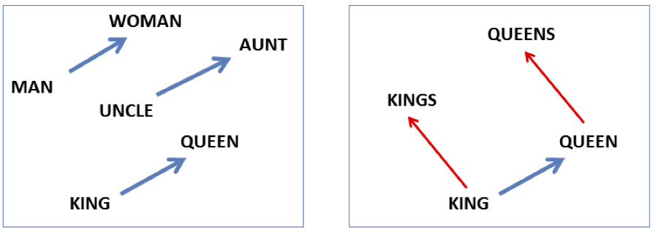
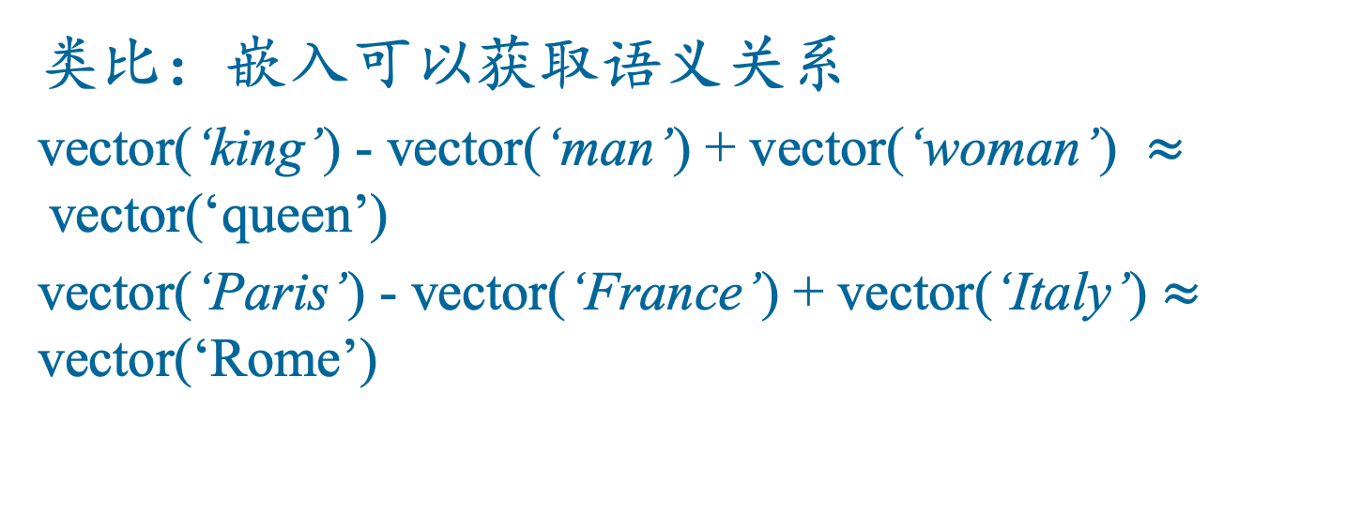
词向量应用与评估
类比：嵌入可以获取语义关系
vector(‘king’) - vector(‘man’) + vector(‘woman’) $≈$vector(‘queen’)
vector(‘Paris’) - vector(‘France’) + vector(‘Italy’) $≈$ vector(‘Rome’)

Slide 78




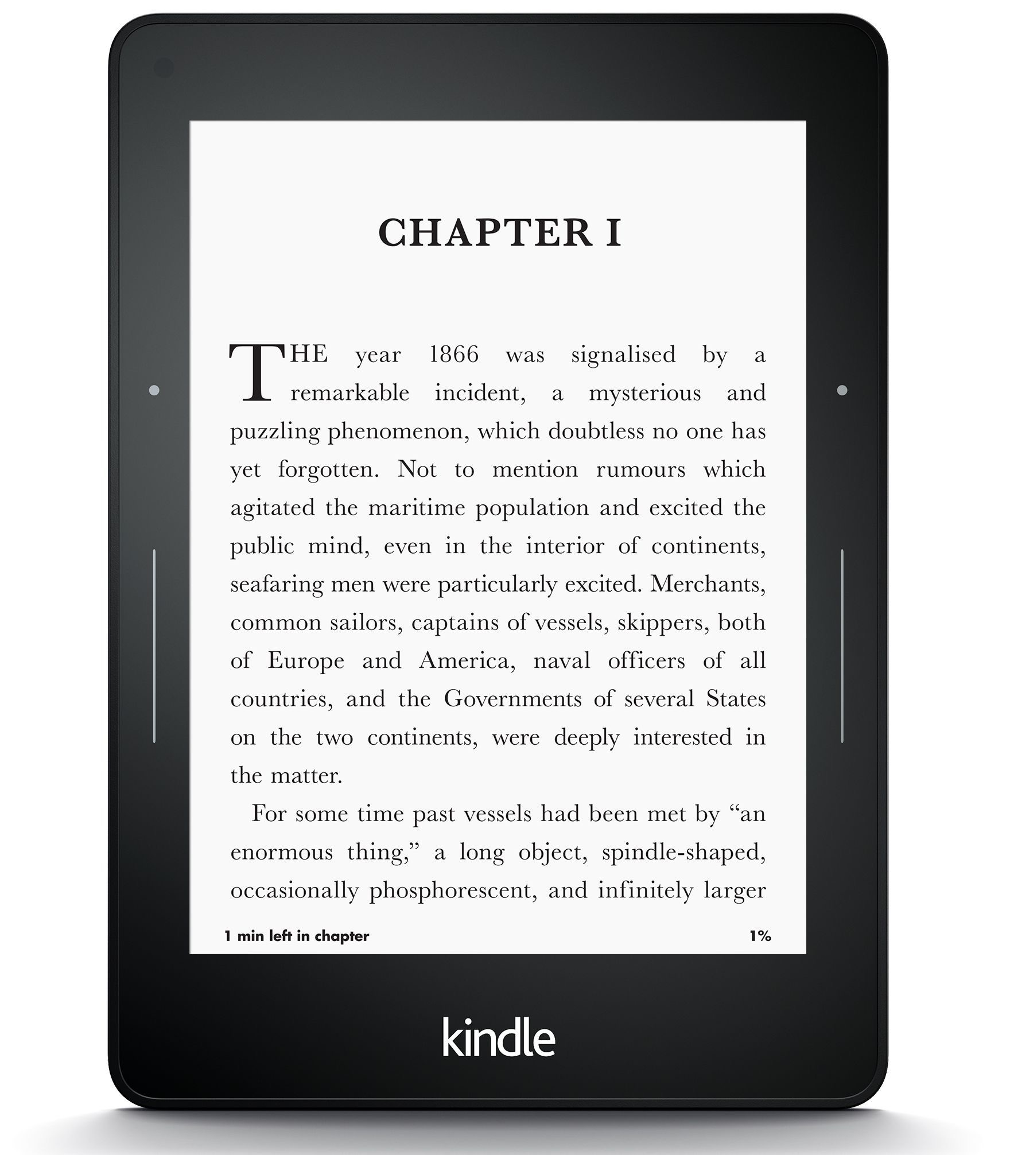
词向量应用与评估
词嵌入能够帮助学习单词历史
1920词向量
词向量1990
“dog” 1990 词向量
“dog” 1920词向量
vs.
1900
1950
2000
￼
￼

Slide 79
词向量评估
与人工评分的相似词任务结果相比较：
WordSim-353 (Finkelstein et al., 2002)
SimLex-999 (Hill et al., 2015)
Stanford Contextual Word Similarity (SCWS) dataset (Huang et al., 2012)
TOEFL dataset: Levied is closest in meaning to: imposed, believed, requested, correlated

Slide 80
总结
词汇语义学
词嵌入思想：使用上下文词汇分布的函数表示词
Tf-idf
PPMI
Word2vec
Skip-gram模型

Slide 81
结束

