Slide 1
自然语言处理 第06章 文本分类
软件学院 刘春
参考：Dan Jurafsky《自然语言处理》

Slide 2

垃圾邮件？

Slide 3


电影评论分类
失望至极！！！
人物搞笑，情节曲折，结尾感人。
有史以来最棒的喜剧。
太可悲了，最糟糕的功夫场面。

Slide 4
文章主题分类
MEDLINE 文章
MeSH 主题类别
安体酮和抑制剂
血液供应
化学
药物治疗
胚胎学
流行病学
…
?

Slide 5
自动问答
自动问答系统(Question Answering System, QA)
世界上最大的宫殿是什么宫殿？
紫禁城/故宫
谁发现了北美洲？
茉莉花每年能开花几次？
黄山在哪个省？
中国人口有多少？
参加希腊奥运会的国家都有哪些？
……

Slide 6
文本分类
主题分类
垃圾文本检测
版权认证
极性识别
语种识别
情感分析
…

Slide 7
文本分类
定义
文本分类任务是指在给定的分类体系中，将文本指定分到某个或某几个类别中
分类对象
短文本：句子、标题、商品评论等
长文本：文章、邮件、网页等
分类体系
人工划分：1) 政治、体育、军事
2) 正能量、负能量
3) 好评、中性、差评
分类模式
二分类 多分类

Slide 8
本章内容
6.1 文本分类模型
6.2 Naïve贝叶斯分类
6.3 Naïve贝叶斯分类与语言模型
6.4 文本分类评估
6.5 Logistics回归文本分类

Slide 9
6.1 文本分类模型
输入：
文档 d
类别集合 C = {c₁, c₂,…, c_{J}}
输出：
预测的类别 c ∈ C

Slide 10
本章内容
6.1 文本分类模型
6.2 Naïve贝叶斯分类
6.3 Naïve贝叶斯分类与语言模型
6.4 文本分类评估
6.5 Logistics回归文本分类

Slide 11
文本分类模型：基于规则
由词和其他特征构成的规则
spam检测:
黑名单邮件地址 OR （“元”AND“发票”）
优点：精确率高
如果规则由专家精心设计
缺点：构建和维持规则集合成本高

Slide 12
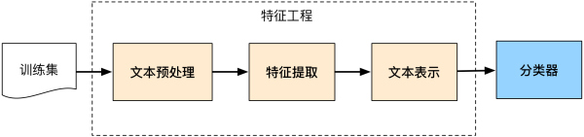
文本分类模型：监督分类方法
流程
文本表示
分类器

Slide 13
文本分类模型：监督分类方法
输入：
文档 d
类别集合 C = {c₁, c₂,…, c_{J}}
m 个文档-类别训练集合
(d₁,c₁),....,(d_{m},c_{m})
输出：
学习的分类器 γ:d → c

Slide 14
文本分类模型：监督分类方法
分类器
Naïve贝叶斯分类
Logistic回归
SVM
k-近邻

Slide 15
本章内容
6.1 文本分类模型
6.2 Naïve贝叶斯分类
6.3 Naïve贝叶斯分类与语言模型
6.4 文本分类评估
6.5 Logistics回归文本分类

Slide 16
Naïve贝叶斯分类
简单分类器
- 基于贝叶斯准则
仅仅基于简单的文档表示
- 词袋

Slide 17
Naïve贝叶斯分类：词袋

Slide 18
Naïve贝叶斯分类：词袋
seen | 2
sweet | 1
whimsical | 1
recommend | 1
happy | 1
... | ...
γ(
)=c

Slide 19
Naïve贝叶斯分类：模型
文档 d 和类别 c

Slide 20
Naïve贝叶斯分类：模型
MAP is “maximum a posteriori” = 最大后验概率
贝叶斯准则
对于所有类别分母一致

Slide 21
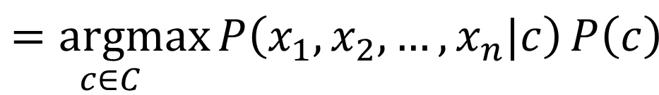
Naïve贝叶斯分类：模型
$$\underset{c∈C}{=argmax}{P\left(x_{1},x_{2},…,x_{n}|c\right)}P\left(c\right)$$
文档 d 表示为特征向量x1..xn

Slide 22
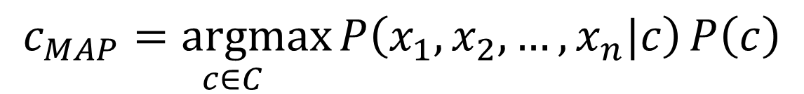
Naïve贝叶斯分类：模型
$$c_{MAP}\underset{c∈C}{=argmax}{P\left(x_{1},x_{2},…,x_{n}|c\right)}P\left(c\right)$$
O(|X|^{n}•|C|) 参数
类别先验概率?
需要大的训练集合进行估计
计算语料中类别的频率

Slide 23

Naïve贝叶斯分类：模型
$$P\left(x_{1},x_{2},…,x_{n}|c\right)$$
词袋假设: 与位置无关
条件独立: 各个特征条件概率P(x_{i}|c_{j})相互独立
$P\left(x_{1},x_{2},…,x_{n}|c\right)=P\left(x_{1}|c\right)∙P\left(x_{2}|c\right)$ $∙$…$∙$ $P\left(x_{n}|c\right)$

Slide 24
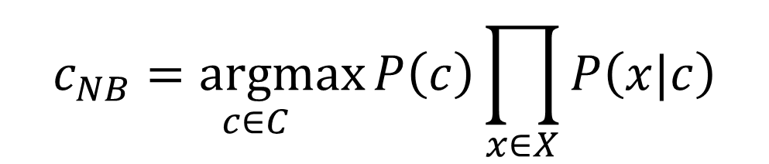
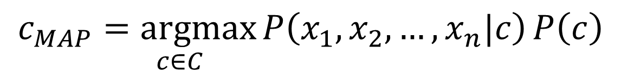
Naïve贝叶斯分类：模型
$$c_{MAP}\underset{c∈C}{=argmax}{P\left(x_{1},x_{2},…,x_{n}|c\right)}P\left(c\right)$$
$$c_{NB}\underset{c∈C}{=argmax}{P\left(c\right)\prod_{x∈X}{P\left(x|c\right)}}$$

Slide 25
Naïve贝叶斯分类：多元模型
假设：
位置 ← 所有文档中的词汇位置

Slide 26
Naïve贝叶斯分类：多元模型
问题：
多个小概率浮点数相乘!
.0006 * .0007 * .0009 * .01 * .5 * .000008….
使用对数 log(ab) = log(a) + log(b)
相乘变相加!

Slide 27
Naïve贝叶斯分类：学习方法
Sec.13.3
最初想法：最大似然估计
计算词语频率

Slide 28

Naïve贝叶斯分类：学习方法
标注类别为$c_{j}$的文档中词$w_{i}$的频次在文档中所有词项中$w∈V$所占的比例
类别为j的大量文档来统计词项频率

Slide 29
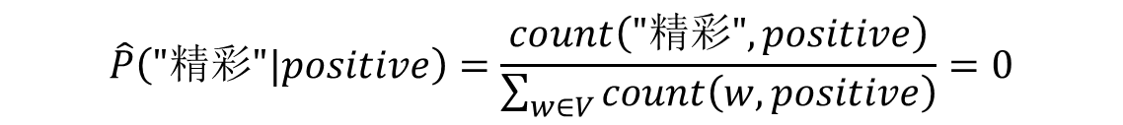
Naïve贝叶斯分类：学习方法
存在问题
训练文本部分词汇未出现，如(精彩)在正向文本(positive)中未出现？
无论文档中出现任何特征词，后验概率均为0！
$$\hat{P}\left("精彩"|positive\right)=\frac{count\left("精彩",positive\right)}{\sum_{w∈V}{count\left(w,positive\right)}}=0$$

Slide 30
Naïve贝叶斯分类： Laplace 平滑

Slide 31
Naïve贝叶斯分类：学习方法
对于训练语料，首先进行词项提取
计算 P(w_{k}|c_{j})
Text_{j} ← 文档集合docs_{j}中的单一文档
词汇集合中的各个词w_{k}
n_{k} ←所有文档Text_{j} 中出现w_{k}频次
计算 P(c_{j})
对于C中每个类别 c_{j}
docs_{j} ← 所有文档 class =c_{j}

Slide 32
 | Doc | Words | Class
Training | 1 | Chinese Beijing Chinese | u
 | 2 | Chinese Chinese Shanghai | u
 | 3 | Chinese Macao | u
 | 4 | Tokyo Japan Chinese | v
Test | 5 | Chinese Chinese Chinese Tokyo Japan | ?
先验概率:
P(u)=
P(v)=
3
4
各个类别:
P(u|d5)
P(v|d5)
1
3/4 * (3/7)³ * 1/14 * 1/14
≈ 0.0003
4
条件概率:
P(Chinese|u) =
P(Tokyo|u) =
P(Japan|u) =
P(Chinese|v) =
P(Tokyo|v) =
P(Japan|v) =
(5+1) / (8+6) = 6/14 = 3/7
(0+1) / (8+6) = 1/14
1/4 * (2/9)³ * 2/9 * 2/9
≈ 0.0001
(0+1) / (8+6) = 1/14
(1+1) / (3+6) = 2/9
(1+1) / (3+6) = 2/9
(1+1) / (3+6) = 2/9

Slide 33
本章内容
6.1 文本分类模型
6.2 Naïve贝叶斯分类
6.3 Naïve贝叶斯分类与语言模型
6.4 文本分类评估
6.5 Logistics回归文本分类

Slide 34
Naïve贝叶斯分类与语言模型
多元Naïve贝叶斯的通用模型
c=中国
X₁=上海
X₂=和
X₃=深圳
X₄=发展
X₅=纽带

Slide 35
Naïve贝叶斯分类与语言模型
Naïve贝叶斯分类能使用各种各样的特征
URL, email地址, 词组, 词性
如果Naïve贝叶斯分类
仅仅使用词项特征
使用文档中的所有词项，且不是其子集
那么
Naïve贝叶斯分类与语言模型基本相同

Slide 36
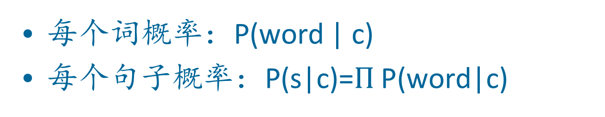
每一个类别 = 一个语言模型
每个词概率：P(word | c)
每个句子概率：P(s|c)=$Π$ P(word|c)
类别 pos
0.1 I
0.1 love
0.01 this
0.05 fun
0.1 film
…
I
love
this
fun
film
0.1
0.1
.01
0.05
0.1
P(s | pos) = 0.0000005

Slide 37
Naïve贝叶斯分类—语言模型
哪个类别下句子s的概率更高？
模型 pos
模型 neg
0.1 I
0.1 love
0.01 this
0.05 fun
0.1 film
0.2 I
0.001 love
0.01 this
0.005 fun
0.1 film
I
love
this
fun
film
0.1
0.1
0.01
0.05
0.1
0.2
0.001
0.01
0.005
0.1
P(s|pos) > P(s|neg)

Slide 38
本章内容
6.1 文本分类模型
6.2 Naïve贝叶斯分类
6.3 Naïve贝叶斯分类与语言模型
6.4 文本分类评估
6.5 Logistics回归文本分类

Slide 39
文本分类评估：混淆矩阵
 | 标签正向 | 标签负向
分类结果正向 | tp | fp
分类结果负向 | fn | tn
Notes:
precision, recall, f-measure [many have seen before]
there are two sets: CORRECT entities and SELECTED entities
2x2 contingency table, four possible outcomes
for precision & recall, you're ignoring bottom corner (where you get O right)
precision: what proportion of your guesses are correct?
note that correctness means (a) correct boundaries, and (b) correct label
recall: what proportion of true entities did you get right?
ASK STUDENTS HERE ABOUT WHY NOT TO USE ACCURACY
[note that there is typically a trade-off between precision and recall!]
[to get high precision, be very reluctant to make guesses – but then you may have poor recall]
[to get high recall, be very promiscuous in making guesses – but then you may have poor precision]

Slide 40
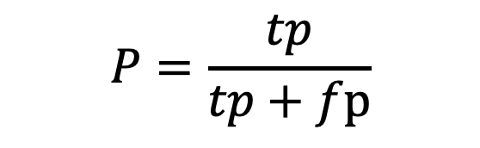
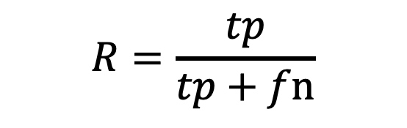
文本分类评估：精确率和召回率
精确率：对于正向类别，分类结果中正确的比率
召回率：对于正向类别，正向标签中被正确分类的比率
$$P=\frac{tp}{tp+fp}$$
$$R=\frac{tp}{tp+fn}$$
 | 标签正向 | 标签负向
分类结果正向 | tp | fp
分类结果负向 | fn | tn

Slide 41
文本分类评估： 混合度量F
混合度量F ，P/R 折中 (加权调和平均):
调和平均的泛化度量；
通常使用 F1 度量
例如 β = 1 (α = ½)：
此时 F = 2PR/(P+R)
Notes:
a combined measure: F-measure: weighted harmonic mean between precision and recall
[why weighted? in some applications you may care more about P or R]
[why harmonic? it's conservative -- lower than arith or geo mean]
[if P and R are far apart, F tends to be near lower value]
[in order to do well on F1, need to do well on BOTH P and R]
[this way, can't beat the system by being either too reluctant or too promiscuous]
Comment: when ppl say f-measure w/o specifying beta, they mean balanced, and this is by far the most common way of doing it

Slide 42
多元分类评价：混淆矩阵 c
类别对<c₁,c₂> ，有多少 c₁ 文档错误分类为c₂?
c_{3,2}: 90 wheat文档错误归类为poultry
测试集文档 | 预测 UK | 预测poultry | 预测wheat | 预测coffee | 预测interest | 预测 trade
真值UK | 95 | 1 | 13 | 0 | 1 | 0
真值poultry | 0 | 1 | 0 | 0 | 0 | 0
真值wheat | 10 | 90 | 0 | 1 | 0 | 0
真值coffee | 0 | 0 | 0 | 34 | 3 | 7
真值interest | - | 1 | 2 | 13 | 26 | 5
真值trade | 0 | 0 | 2 | 14 | 5 | 10

Slide 43
多元分类评价：评估指标
Sec. 15.2.4
召回率:
类别为i的文档中，被正确分类的比例：
精确率:
分类类别为i的文档中正确（真实类别为i ）的比例：
准确率: (1 - error rate)
文档被正确分类的比例：

Slide 44
开发测试集合交叉认证
度量指标: P/R/F1
未训练的测试集
避免过拟合 (‘由测试集进行微调’)
更有效的性能评估
交叉认证：训练集开发集多切割
由不同的数据集中处理采样偏差
综合多组测试集结果
综合开发测试集性能
训练集
开发测试集
测试集
训练集
开发集
训练集
开发集
训练集
开发集
测试集

Slide 45
开发测试集合交叉认证
多次切分

Slide 46
本章内容
6.1 文本分类模型
6.2 Naïve贝叶斯分类
6.3 Naïve贝叶斯分类与语言模型
6.4 文本分类评估
6.5 Logistics回归文本分类

Slide 47
Logistics回归文本分类
6.5.1 Logistics回归模型
6.5.2 Logistics回归模型概率解释
6.5.3 Logistics回归学习
6.5.4 多元Logistics回归

Slide 48

logistics回归
生成模型
计算 $P\left(c,d\right)$
鉴别模型
直接计算 $P\left(c|d\right)$

Slide 49

文本分类：模型
输入：
文档 x
类别集合 C = {c₁, c₂,…, c_{J}}
输出：
预测的类别 $\hat{y}$ ∈ C

Slide 50
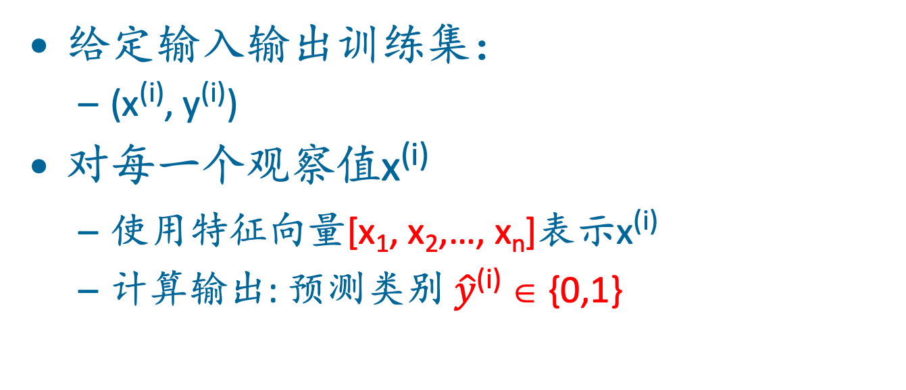
二元Logistics回归：模型
给定输入输出训练集：
(x^{(i)}, y^{(i)})
对每一个观察值x^{(i)}
使用特征向量[x₁, x₂,…, x_{n}]表示x^{(i)}
计算输出: 预测类别 $\hat{y}$^{(i)} ∈ {0,1}

Slide 51
Logistics回归：特征定义
对于特征 x_{i}, 权重 w_{i} 表征 x_{i} 的重要程度
x_{i} =“评论包含词‘awesome’": w_{i} = +10
x_{j} ="评论包含词‘abysmal’": w_{j} = -10
x_{k} =“评论包含词 ‘mediocre’": w_{k} = -2
Notes:
The weight wi represents how important that input feature is to the classification decision, and can be positive (providing evidence that the in- stance being classified belongs in the positive class) or negative (providing evidence that the instance being classified belongs in the negative class). Thus we might expect in a sentiment task the word awesome to have a high positive weight, and abysmal to have a very negative weight.

Slide 52
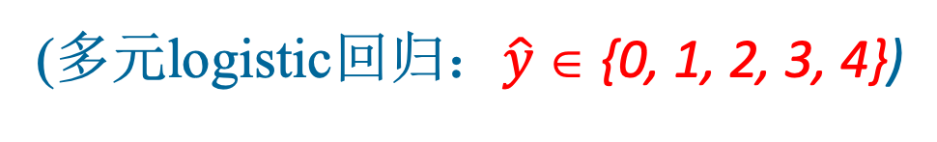
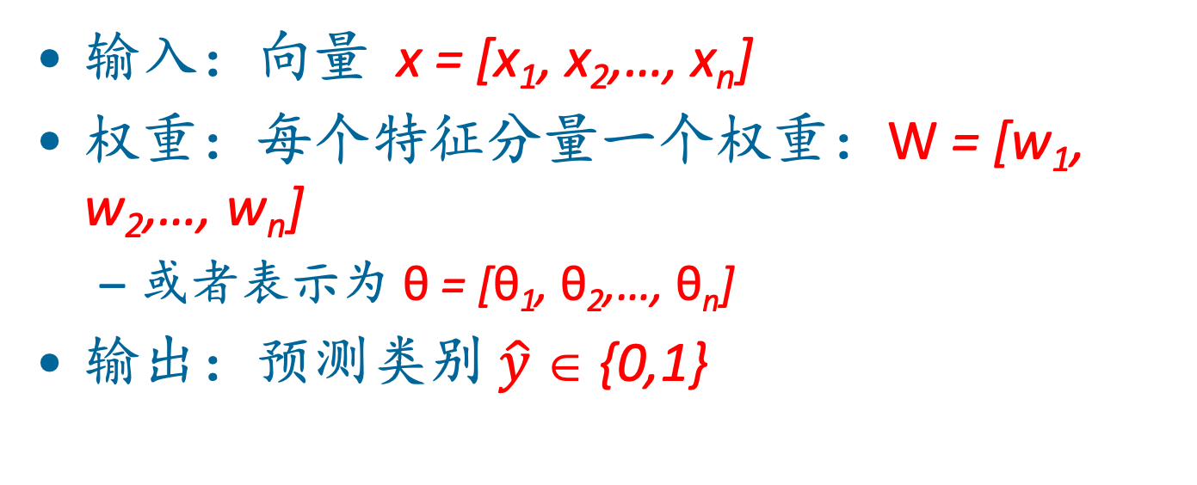
Logistics回归：特征
输入：向量 x = [x₁, x₂,…, x_{n}]
权重：每个特征分量一个权重：W = [w₁, w₂,…, w_{n}]
或者表示为 θ = [θ₁, θ₂,…, θ_{n}]
输出：预测类别 $\hat{y}$ ∈ {0,1}
(多元logistic回归：$\hat{y}$ ∈ {0, 1, 2, 3, 4})

Slide 53

Logistics回归：如何构造分类函数
对每个特征 x_{i}, 权重 w_{i} 表征 x_{i} 的重要程度
对特征进行加权求和并增加偏置
如果 $z$ 高于一定值, 则y=1; 否则 y=0
Notes:
The bias term, also called the intercept, is another real number that’s added to the weighted inputs. In the rest of the book we’ll represent such sums using the dot product notation from linear algebra. The dot product of two vectors a and b, written as a · b is the sum of the products of the corresponding elements of each vector.

Slide 54
Logistics回归：问题 z 不是概率!
方案：归一化到 0 - 1
Notes:
nothing in Eq. 5.3 forces z to be a legal probability, that is, to lie between 0 and 1. In fact, since weights are real-valued, the output might even be negative; z ranges from −∞ to ∞.

Slide 55
Logistics回归：sigmoid 函数
Notes:
The sigmoid function The 1/1+e^-z (so-named because it looks like an s) is also called the logistic function. It takes a real value and maps it to the range [0, 1
It is nearly linear around 0 but outlier values get squashed toward 0 or 1.

Slide 56
Logistics回归：流程
首先计算w∙x+b
然后经过sigmoid函数：
σ(w∙x+b)
进行判断

Slide 57
Logistics回归： sigmoids函数计算概率
Notes:
We’re almost there. If we apply the sigmoid to the sum of the weighted features, we get a number between 0 and 1. To make it a probability, we just need to make sure that the two cases, p(y = 1) and p(y = 0), sum to 1. We can do this as follows:

Slide 58
Logistics回归
=
Because
Notes:
The sigmoid function has the property

Slide 59
Logistics回归：决策
这里0.5称为决策边界

Slide 60
Sigmoid函数
P(y=1)
wx + b

Slide 61
Logistics回归：分类决策
if w∙x+b > 0
if w∙x+b ≤ 0

Slide 62
Logistics回归
6.5.1 Logistics回归模型
6.5.2 Logistics回归模型概率解释
6.5.3 Logistics回归学习
6.5.4 多元Logistics回归

Slide 63
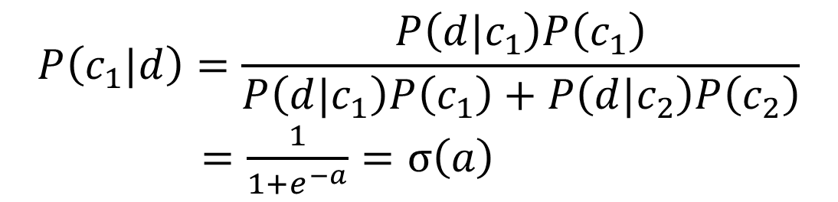
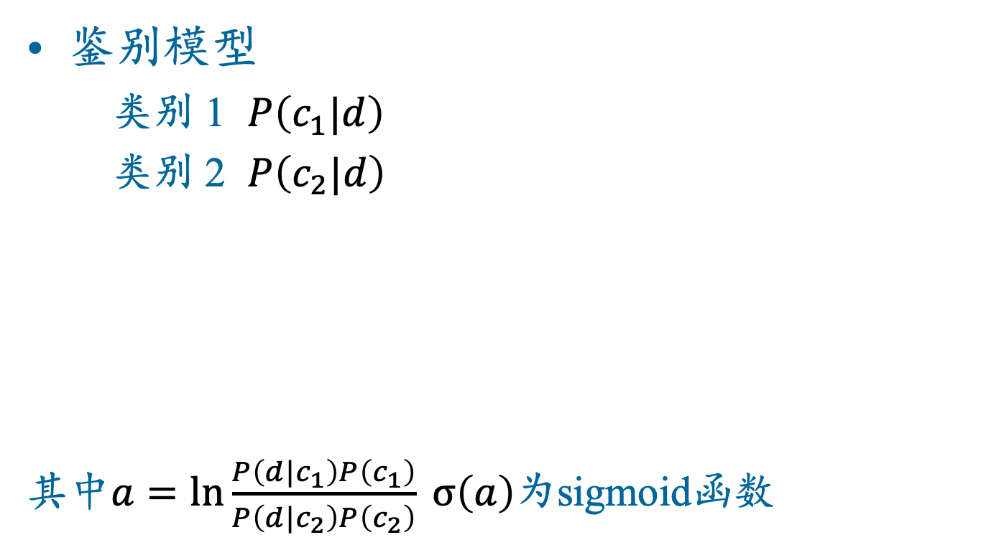
logistics回归：二元
鉴别模型
类别 1 $P\left(c_{1}|d\right)$
类别 2 $P\left(c_{2}|d\right)$
其中$a=ln\frac{P\left(d|c_{1}\right)P\left(c_{1}\right)}{P\left(d|c_{2}\right)P\left(c_{2}\right)} σ\left(a\right)$为sigmoid函数
$$P\left(c_{1}|d\right)=\frac{P\left(d|c_{1}\right)P\left(c_{1}\right)}{P\left(d|c_{1}\right)P\left(c_{1}\right)+P\left(d|c_{2}\right)P\left(c_{2}\right)}$$
$=\frac{1}{1+e^{−a}}=σ\left(a\right)$

Slide 64


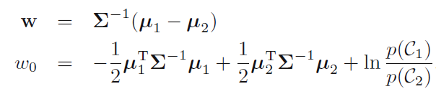

logistics回归：高斯分布
通常文档$d$表示为特征向量$x=\left(x_{1},x_{2},…,x_{n}\right)$
若 $P\left(x|c_{k}\right)$ 服从多元高斯分布
有
其中
$P\left(c_{1}|d\right)=\frac{1}{1+e^{−a}}=σ\left(w^{T}x+b\right)$ (${b=w}_{0}$)

Slide 65
举例：情感分类y=1 或 y=0?
It's hokey . There are virtually no surprises , and the writing is second-rate . So why was it so enjoyable ? For one thing , the cast is great. Another nice touch is the music . I was overcome with the urge to get off the couch and start dancing . It sucked me in , and it'll do the same to you .
Notes:
Suppose we are doing binary sentiment classification on movie review text, and we would like to know whether to assign the sentiment class 1=positive or 0=negative to the following review

Slide 66
Notes:
We’ll represent each input observation by the 6 features x1...x6 of the input

Slide 67
其中 w =
b = 0.1
Notes:
Let’s assume for the moment that we’ve already learned a real-valued weight for each of these features, and that the 6 weights corresponding to the 6 features are as follows. The weight w1, for example indicates how important a feature the number of positive lexicon words (great, nice, enjoyable, etc.) is to a positive sentiment decision, while w2 tells us the importance of negative lexicon words. Note that w1 = 2.5 is positive, while w2 = −5.0, meaning that negative words are negatively associated with a positive sentiment decision, and are about twice as important as positive words.

Slide 68
Notes:
Given these 6 features and the input review x, we can compute P(+|x) and P(−|x)

Slide 69
分类器特征构建：标点消歧
End of sentence
This ends in a period.
The house at 465 Main St. is new.
Not end
Notes:
We might use features like x1 below expressing that the current word is lower case and the class is EOS (perhaps with a positive weight), or that the current word is in our abbreviations dictionary (“Prof.”) and the class is EOS (perhaps with a negative weight). A feature can also express a quite complex combination of properties. For example a period following an upper case word is likely to be an EOS, but if the word itself is St. and the previous word is capitalized, then the period is likely part of a shortening of the word street.

Slide 70
二元logistics回归：总结
给定：
分类类别: (+ 情感,- 情感)
特征向量x[x1, x2, …, xn]
x1= ( “awesome”)词频
x2 = log(词频)
权重向量w [w1, w2, …, wn]
w_{i} 为特征 x_{i}的权重

Slide 71
Logistics回归
6.5.1 Logistics回归模型
6.5.2 Logistics回归模型概率解释
6.5.3 Logistics回归学习
6.5.4 多元Logistics回归

Slide 72
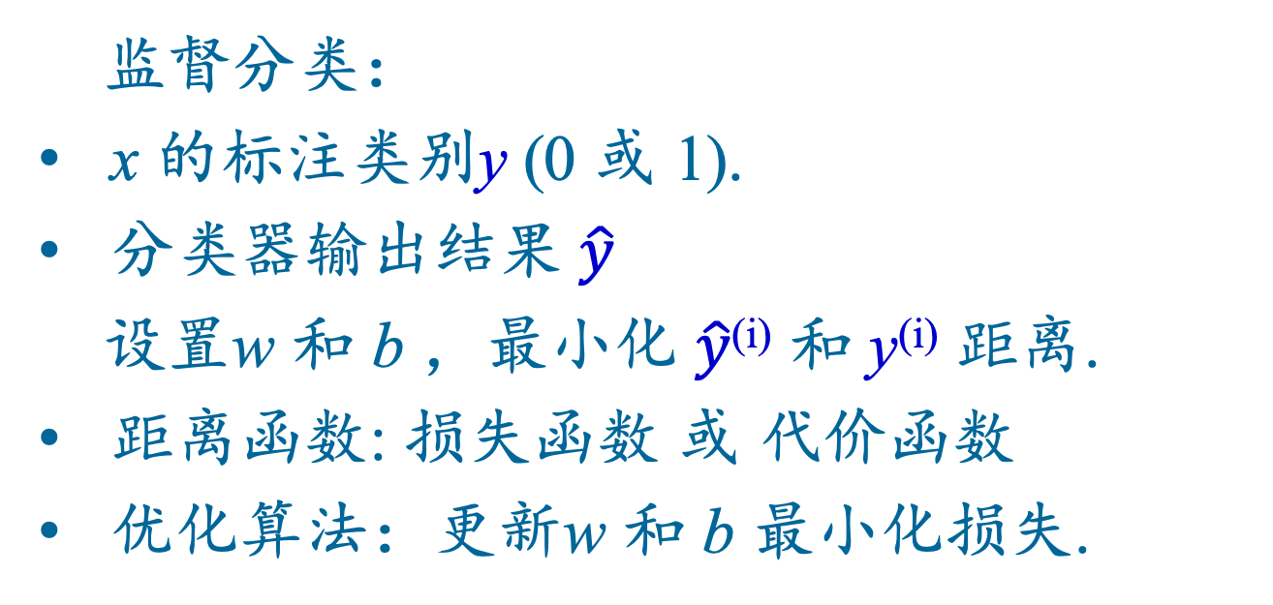
参数学习
监督分类：
x 的标注类别y (0 或 1).
分类器输出结果 $\hat{y}$
设置w 和 b ，最小化 $\hat{y}$^{(i)} 和 y^{(i)} 距离.
距离函数: 损失函数 或 代价函数
优化算法：更新w 和 b 最小化损失.
Notes:
Logistic regression is an instance of supervised classification in which we know the correct label y (either 0 or 1) for each observation x. But what the system produces is an estimate, ^y. We want to learn parameters (meaning w and b) that make yˆ for each training observation as close as possible to the true y.

Slide 73
学习成分
损失函数：
交叉熵损失函数
优化算法：
随机梯度速降
Notes:
This requires two components. The first is a metric for how close the current label (yˆ) is to the true gold label y. Rather than measure similarity, we usually talk about the opposite of this: the distance between the system output and the gold output, and we call this distance
the loss function or the cost function. We'll we’ll introduce the loss function that is commonly used for logistic regression and also for neural networks, the cross-entropy loss. The second thing we need is an optimization algorithm for iteratively updating
the weights so as to minimize this loss function. The standard algorithm for this is gradient descent; we’ll introduce the stochastic gradient descent algorithm in the following section.

Slide 74

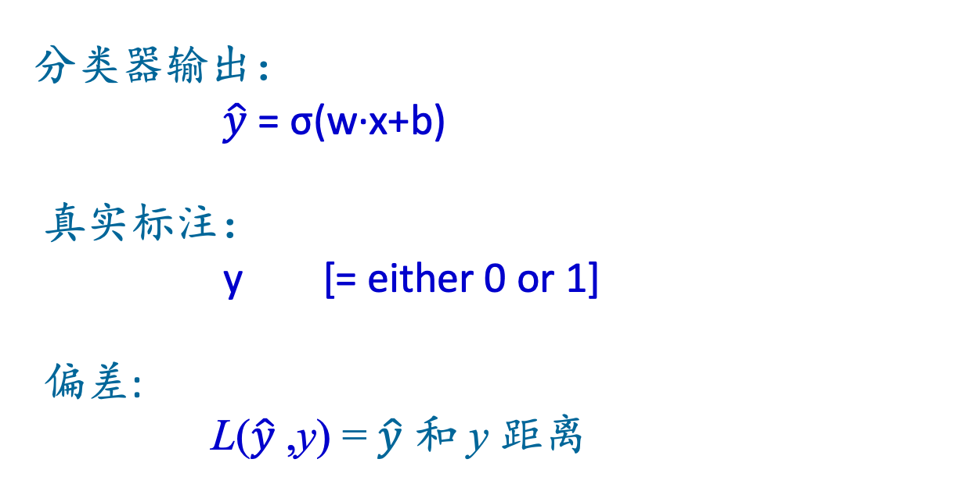
$\hat{y} 和$ y距离
分类器输出：
$\hat{y}$= σ(w∙x+b)
真实标注：
y [= either 0 or 1]
偏差:
L($\hat{y}$,y) = $\hat{y}$ 和 y 距离
Notes:
We need a loss function that expresses, for an observation x, how close the classifier output (yˆ = σ (w · x + b)) is to the correct output (y, which is 0 or 1).

Slide 75
logistics回归：负对数似然函数损失
最大似然估计
选择参数w,b 最大化
对数概率
已知训练数据的真实类别y
给定观察数据 x
Notes:
We do this via a loss function that prefers the correct class labels of the training examples to be more likely. This is called conditional maximum likelihood estimation: we choose the parameters w,b that maximize the log probability of the true y labels in the training data given the observations x. The resulting loss function is the negative log likelihood loss, generally called the cross-entropy loss.

Slide 76
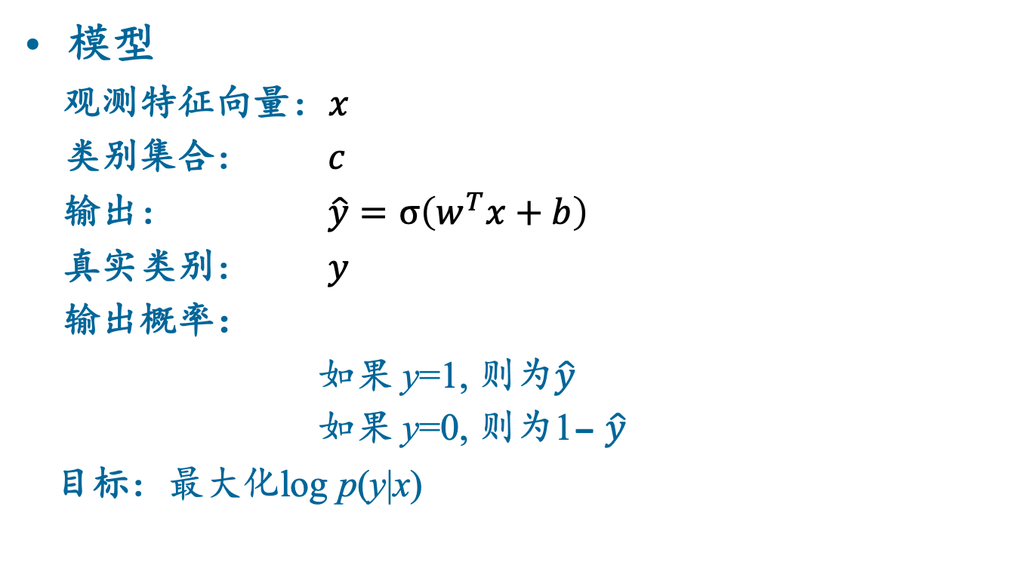
logistics回归：交叉熵
模型
观测特征向量：$x$
类别集合： $c$
输出： $\hat{y}=σ\left(w^{T}x+b\right)$
真实类别： $y$
输出概率：
如果 y=1, 则为$\hat{y}$
如果 y=0, 则为1- $\hat{y}$
目标：最大化log p(y|x)

Slide 77
logistics回归：交叉熵
最大化：
最大化 log p(y|x) 等价于最大化 p(y|x)
最大化：

Slide 78
logistics回归：交叉熵
目标：最大似然概率 p(y|x)
Maximize:
交叉熵损失：
Minimize:

Slide 79
例：
我们希望损失函数满足：
估计值越接近真值越小
假设以下评论真实情感类别为 y=1 (positive)
It's hokey . There are virtually no surprises , and the writing is second-rate . So why was it so enjoyable ? For one thing , the cast is great . Another nice touch is the music . I was overcome with the urge to get off the couch and start dancing . It sucked me in , and it'll do the same to you .

Slide 80
例：
真值 y=1. 模型输出?
损失?

Slide 81
例：
假设真实标签为 y=0.
损失?
Notes:
By contrast, let’s pretend instead that the example was actually negative, i.e., the true y = 0 (perhaps the reviewer went on to say “But bottom line, the movie is terrible! I beg you not to see it!”) . In this case our model is confused, the model is wrong, so we’d want the loss to be higher. Let's plug in y = 0 and 1−σ(w·x+b) = .31

Slide 82
例：
真值为 y=1时，损失为
真值为 y=0 时，损失为
损失定义满足要求!

Slide 83

logistics回归：最小化损失
参数集合表示为 𝛳=(w,b)
将$\hat{y}$表示为 f (x; θ )
选择参数使得所有样本平均损失最小化：
Notes:
Our goal with gradient descent is to find the optimal weights: minimize the loss function we’ve defined for the model. We’ll explicitly represent the fact that the loss function L is parameterized by the weights, which we can refer to in machine learning in general as θ (in the case of logistic regression θ = w, b). And we’ll represent $\hat{y}$as f (x; θ ) to make the dependence on θ more obvious. So the goal is to find the set of weights which minimizes the loss function, averaged over all examples: EQ

Slide 84

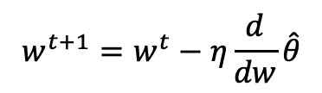
logistics回归：学习
参数学习—梯度下降
最小化交叉熵
梯度学习
$$w^{t+1}=w^{t}−η\frac{d}{dw}\hat{θ}$$

Slide 85
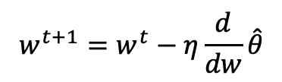
logistics回归：学习
参数学习—梯度下降
最小化交叉熵
梯度学习
$$w^{t+1}=w^{t}−η\frac{d}{dw}\hat{θ}$$

Slide 86
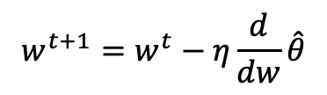
logistics回归：学习
参数学习—梯度下降
最小化交叉熵
梯度学习
$$w^{t+1}=w^{t}−η\frac{d}{dw}\hat{θ}$$

Slide 87
logistics回归：学习
梯度是损失函数变化最快的方向
梯度速降：找出当前点损失函数的梯度方向，然后沿着梯度相反方向变化参数

Slide 88
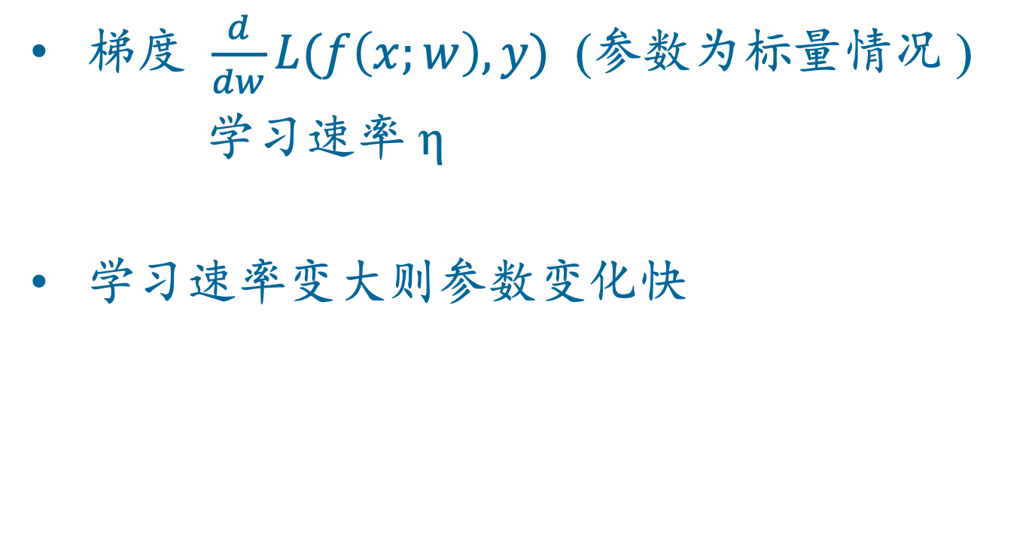
logistics回归：学习
梯度 $\frac{d}{dw}L(f\left(x;w\right),y)$ (参数为标量情况 )
学习速率 η
学习速率变大则参数变化快
Notes:
The magnitude of the amount to move in gradient descent is the value of the slope of the loss function (with respect to w) weighted by a learning rate η . A higher (faster) learning rate means that we should move w more on each step. The change we make in our parameter is the learning rate times the gradient (or the slope, in our single-variable example)

Slide 89
logistics回归：学习
N维参数情况下梯度为矢量
2 维, w 和 b
红色箭头表示红点的梯度方向
Notes:
If we’re just imagining two weight dimensions (say for one weight w and one bias b), the gradient might be a vector with two orthogonal components, each of which tells us how much the ground slopes in the w dimension and in the b dimension. This figure shows a visualization of the value of a 2-dimensional gradient vector taken at the red point.

Slide 90
logistics回归：学习
将$\hat{y}$表示为 f (x; θ ) ：
θ 更新方程
Notes:
Here's a vector of gradients. We’ll represent yˆ as f (x; θ ) to make the dependence on θ more obvious:

Slide 91
logistics回归：学习
损失函数
损失函数对参数的偏导数
Notes:
In order to update θ , we need a definition for the gradient ∇L( f (x; θ ), y). Recall that for logistic regression, the cross-entropy loss function is: EQ
It turns out that the derivative of this function for one observation vector x is EQ
Note that the gradient with respect to a single weight w j represents a very intuitive value: the difference between the true y and our estimated yˆ = σ (w · x + b) for that observation, multiplied by the corresponding input value x j .

Slide 92
logistics回归：学习
超参数 η
太大：更新步长过大，可能跳过最优值
太小：学习时间长
超参数 ：
机器学习模型中一类特别的参数
与普通参数通过监督训练学习获得不同, 超参数由算法设计者选择.
Notes:
The learning rate η is a hyperparameter that must be adjusted. If it’s too high, the learner will take steps that are too large, overshooting the minimum of the loss function. If it’s too low, the learner will take steps that are too small, and take too long to get to the minimum. It is common to start with a higher learning rate and then slowly decrease it. Hyperparameters are a special kind of parameter for any machine learning model. Unlike regular parameters of a model (weights like w and b), which are learned by the algorithm from the training set, hyperparameters are special parameters chosen by the algorithm designer that affect how the algorithm works.

Slide 93
随机梯度速降
梯度速降的一步实现过程：
情感分类示例, 其中y=1 (positive)
两个特征:
x₁ = 3 (正向词的个数)
x₂ = 2 (负向词的个数)
假设 3 个参数 (2 权重 1 偏置) ， Θ⁰ 都为0：
w₁ = w₂ = b = 0
η = 0.1
Notes:
Let’s walk though a single step of the gradient descent algorithm. We’ll use a simplified version of our sentiment classification example as it sees a single observation x, whose correct value is y = 1 (this is a positive review), and with only two features: x1 = 3 (count of positive lexicon words), and x2 = 2 (count of negative lexicon words). Let’s assume the initial weights and bias in θ_0 are all set to 0, and the initial learning rate η is 0.1:

Slide 94
随机梯度速降：例
w₁ = w₂ = b = 0;
x₁ = 3; x₂ = 2
参数θ 更新方程：
这里
梯度向量为三维：
Notes:
Here's our update equation for SGD. In order to do this update to theta, we'll need to know the gradient of the loss function. In our mini example there are three parameters, so the gradient vector has 3 dimensions, for w1, w2, and b. We can compute the first gradient as follows:

Slide 95
随机梯度速降：例
w₁ = w₂ = b = 0;
x₁ = 3; x₂ = 2
参数θ 更新方程：
这里
梯度向量为三维：
Notes:
Here's our update equation for SGD. In order to do this update to theta, we'll need to know the gradient of the loss function. In our mini example there are three parameters, so the gradient vector has 3 dimensions, for w1, w2, and b. We can compute the first gradient as follows:

Slide 96
随机梯度速降：例
w₁ = w₂ = b = 0;
x₁ = 3; x₂ = 2
参数θ 更新方程：
这里
梯度向量为三维：
Notes:
Here's our update equation for SGD. In order to do this update to theta, we'll need to know the gradient of the loss function. In our mini example there are three parameters, so the gradient vector has 3 dimensions, for w1, w2, and b. We can compute the first gradient as follows:

Slide 97
随机梯度速降：例
w₁ = w₂ = b = 0;
x₁ = 3; x₂ = 2
参数θ 更新方程：
这里
梯度向量为三维：
Notes:
Here's our update equation for SGD. In order to do this update to theta, we'll need to know the gradient of the loss function. In our mini example there are three parameters, so the gradient vector has 3 dimensions, for w1, w2, and b. We can compute the first gradient as follows:

Slide 98
随机梯度速降：例
新参数 θ¹ 通过移动 θ⁰ 沿着梯度反方向:
η = 0.1;

Slide 99
随机梯度速降：例
新参数 θ¹ 通过移动 θ⁰ 沿着梯度反方向:
η = 0.1;

Slide 100
随机梯度速降：例
新参数 θ¹ 通过移动 θ⁰ 沿着梯度反方向:
η = 0.1;

Slide 101
最小批次训练
随机梯度速降法每次随机选择一个样本进行训练.
更常用的方法是每次选择一批数据进行训练.
批训练：整个数据集
最小批次训练：每次m个样本 (512, 或 1024)
Notes:
Stochastic gradient descent is called stochastic because it chooses a single random example at a time, moving the weights so as to improve performance on that single example. That can result in very choppy movements, so it’s common to compute the gradient over batches of training instances rather than a single instance.
For example in batch training we compute the gradient over the entire dataset. By seeing so many examples, batch training offers a superb estimate of which direction to move the weights, at the cost of spending a lot of time processing every single example in the training set to compute this perfect direction.
A compromise is mini-batch training: we train on a group of m examples (perhaps 512, or 1024) that is less than the whole dataset.
Mini-batch training also has the advantage of computational efficiency. The mini-batches can easily be vectorized, choosing the size of the mini-batch based on the computational resources. This allows us to process all the exam- ples in one mini-batch in parallel and then accumulate the loss, something that’s not possible with individual or batch training.

Slide 102
Logistics回归
6.5.1 Logistics回归模型
6.5.2 Logistics回归模型概率解释
6.5.3 Logistics回归学习
6.5.4 多元Logistics回归

Slide 103
多元Logistics回归
类别高于2类
正向/负向/中性
词性标注 (名词, 动词, 形容词, 副词, 介词等.)
如果 >2类使用多元Logistics回归
= Softmax回归
= 多元logit
= 未使用的名字：最大熵模型 或 MaxEnt
“logistics回归” 特指两类

Slide 104
多元Logistics回归
多个类别的概率之和需为1
P(positive|doc) + P(negative|doc) + P(neutral|doc) = 1
将sigmoid 泛化到多元称为 softmax
选择一个k维向量 z = [z1, z2, ..., zk]
输出一个概率分布
每一个值在范围 [0,1]之间
所有值求和为1

Slide 105
多元Logistics回归：softmax
将k维向量z = [z₁, z₂, … , z_{k}] 归一化为概率分布

Slide 106
多元Logistics回归
将向量 z = [z₁,z₂,...,z_{k}] 转化为概率向量

Slide 107
多元Logistics回归
输入仍然是权重向量w和输入向量x的乘积
输出是属于各个类别的概率.

Slide 108
多元Logistics回归
二元：正权重→ y=1 负权重→ y=0
多元：每一类分别指定权重
w₅ = 3.0

Slide 109
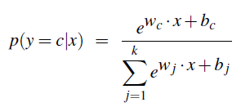
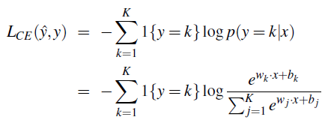
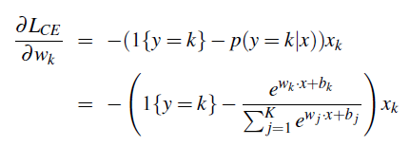
多元Logistics回归
类别概率
学习

Slide 110
本章小结
文本分类模型
Naïve贝叶斯分类
最大后验概率
词袋表示
特征词相互独立
模型学习
加1平滑
文本分类性能评估
精确率
召回率
F测度
训练数据划分
Logistics回归
Logistics回归模型
概率解释
学习方法
多元模型

Slide 111
结束

